Slide 1
Secondary Module
Neuroplasticity 1
How We Learn
Notes:
Teacher: We are going to watch a video. It is about what happens in our brain when we learn and how it feels when we learn something new. Following the video, we will be doing a thinking routine called SEE, THINK, WONDER. Watch the video with this in mind. I won’t speak while the video is playing and I will ask you to do the same so we can focus on the narration.
Play video

Slide 2
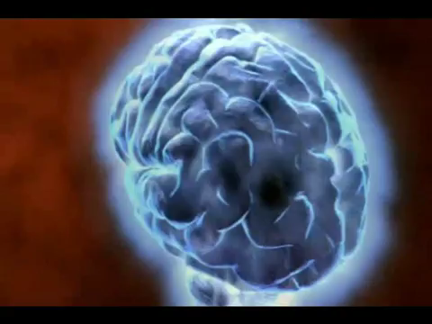
ThinkPlus

Slide 3



ThinkPlus
SEE
THINK
WONDER
Notes:
Teacher: Now you’ve watch the video, you will use the SEE, THINK, WONDER routine to clarify your observations, understandings and thoughts.

Slide 4

ThinkPlus
SEE
Notes:
Teacher: What did you see? Record everything you saw in the video- objects, surroundings, actions- in the SEE section of your activity sheet. Remember this what you think about what you see, just what you can see.
SEE can be done as a whole group with teacher recording student observations on board or large chart as they are shared or students record observations in groups of 2 or more and then share with class.

Slide 5
ThinkPlus
THINK
Notes:
Teacher: What did you think? Use your SEE list as a guide to your thinking about the video -the use of analogies, the message/s. Record your thoughts in the THINK section of your activity sheet.
THINK can be done individually or in pairs. Students record their thoughts on THINK chart. These can then be shared and discussed with whole group.

Slide 6


ThinkPlus
WONDER
Notes:
Teacher: What do you wonder about after viewing this video? What questions do you have about the content and message of the video? Record your wonderings in the WONDER section of your activity sheet.
WONDER can be done individually or in pairs. Students record their wonderings on WONDER chart. These can then be shared and discussed with whole group.

Slide 7

ThinkPlus
Research
Notes:
Teacher: You are now going to research one of the wonderings (yours or someone else’s) and share it with the group. Present your findings in an interesting way – poster, video, poem, model.
Students (individually or in groups) choose a WONDER statement to research. (This could be done over several sessions or set as a home task). Students share findings with class. List any questions that couldn’t be answered for future research.

Slide 8
ThinkPlus
Notes:
Teacher: Let’s watch the video again keeping in mind our observations, thoughts and questions.

Slide 9
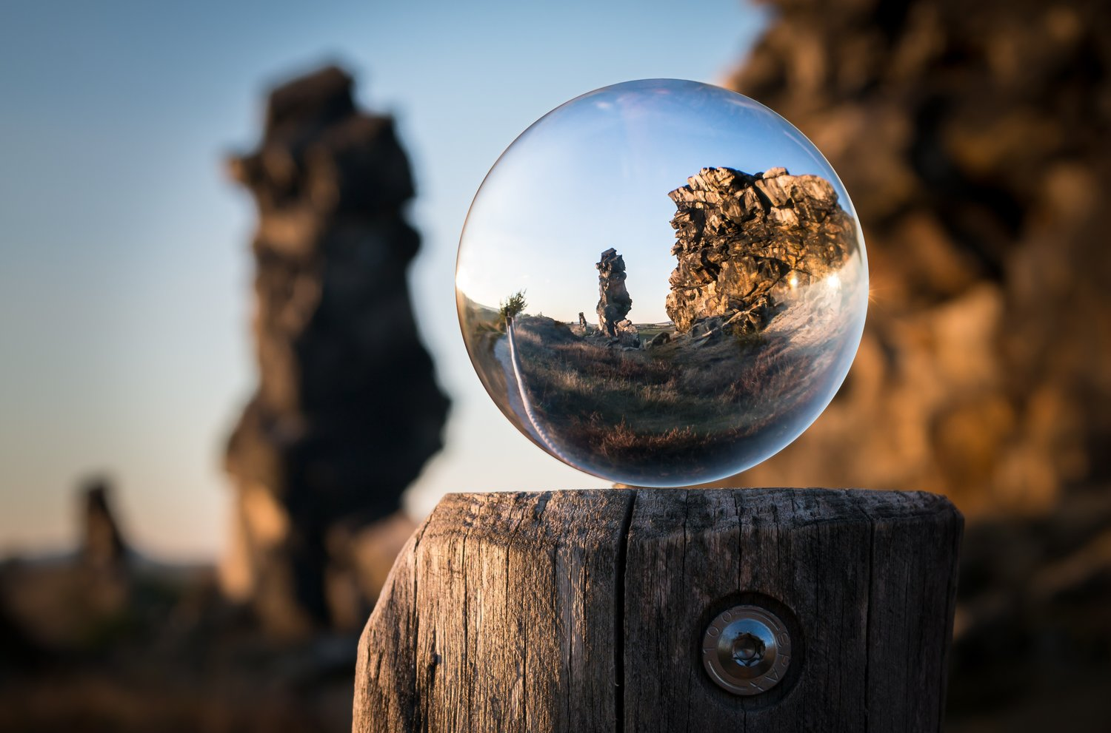
ThinkPlus
Reflection
Notes:
Teacher: Could you add to any of the charts we created now you have seen it again? Did you SEE more, THINK more, WONDER more?
If students do have more to share, add to charts and discuss.

