Slide 1
Secondary Module
Neuroplasticity 2
This Week I Learnt

Slide 2
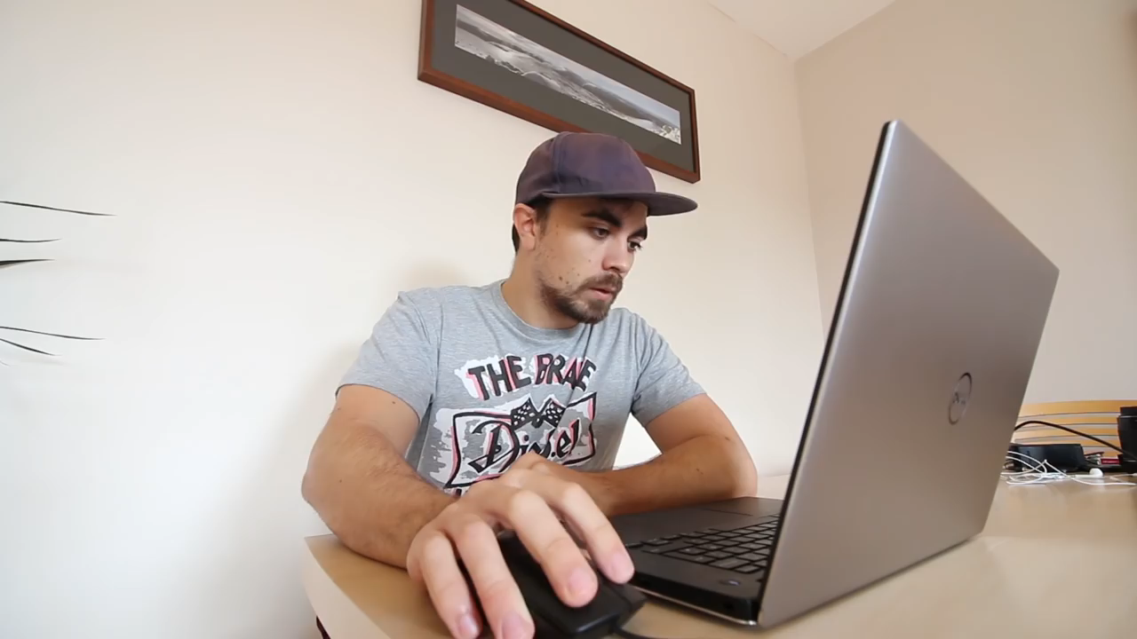
ThinkPlus
Notes:
This Week I Learnt How to Throw Cards Video

Slide 3
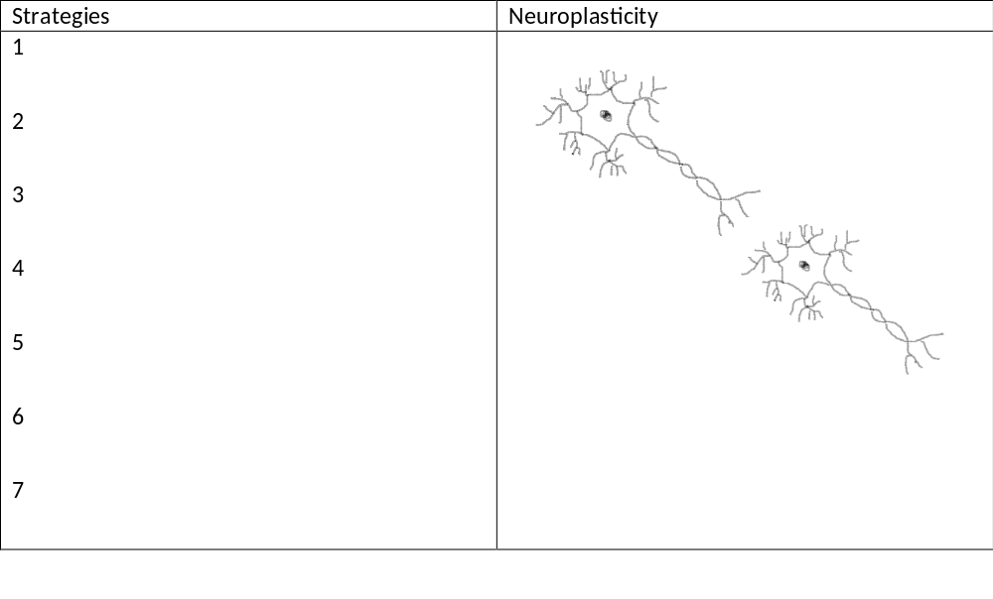
Notes:
Class Activity- Can be projected onto whiteboard

Slide 4
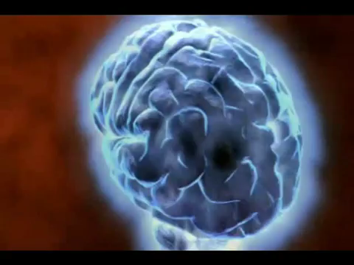
ThinkPlus
Notes:
How We Learn- Synapses and Neural Pathways Video

