Slide 1
Secondary Module
Neuroplasticity 3
Headlines

Slide 2
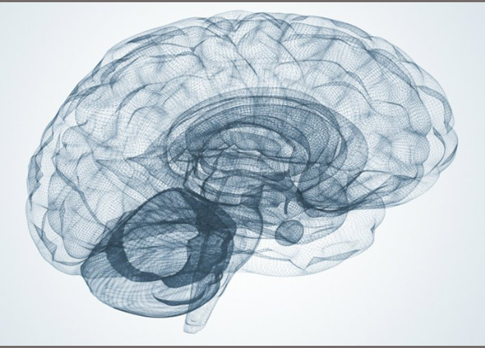
ThinkPlus
When you leave this room today,
your brain will not be the same as it was when you entered.
Notes:
Have first line of quote displayed as students walk into session
Teacher: Can you guess what the rest of this quote might be? Look at the picture – it might give you a clue.
After student suggestions reveal the rest of the quote and ask what students think it might mean. At this stage do not discuss its true meaning – neuroplasticity.
Teacher: We will talk more about this quote later.

Slide 3
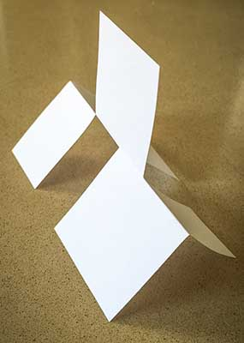
ThinkPlus
Look
Move around
Don’t touch
Notes:
Have student sitting a tables of 6-8. Each table should have scissors for each students and light card cut into A6 – 5 per student.
Teacher: In a moment, you are going to recreate this paper structure. Each of you will have paper and a pair of scissors to use. I will place the structure in the middle of each table. (animation 1)You may look at it, (animation 2) move around to look at it from different angles, (animation 3) but you cannot touch it. I will give you about 10 minutes to recreate the structure.
Place a structure on each table of six and students begin.
Encourage students to discuss their ideas, thoughts and feelings as they attempt the task. Do not offer any advice or encouragement during the activity. If a participant is able to make the structure, ask that they do not disclose the solution.
While students are working, record any comments that are made. After 7-8 minutes, write comments on the board. Do not make any comment or identify to whom the comments belong. Add any comments that you hear while writing on the board. Continue to add to comments until the activity is finished (about 10 minutes.)

Slide 4
ThinkPlus
Did anyone make it?
How long did it take?
How many attempts?
Notes:
Teacher: Did anyone make it? (animation 1) How long did it take? (animation 2) How many attempts?

Slide 5
ThinkPlus
First ten seconds?
How?
Why?
Notes:
Teacher: Was the first ten seconds of trying much different from the last ten seconds? (animation 1) How? (animation 2) Why?

Slide 6
ThinkPlus
How many attempts?
Give up?
Notes:
Teacher: How many attempts did you have? (animation 1) Did anyone just give up?

Slide 7
ThinkPlus
What were others doing?
How did it make you feel?
Notes:
Teacher: Did you look at what other people were doing? Why? (animation 1) How did it make you feel? Did you learn anything from what they were doing?
At this stage, you can demonstrate how to make the structure. Some students may not want to see the solution as they want to continue working on it later.

Slide 8
ThinkPlus
What comments were made?
Feelings?
Thoughts?
Notes:
Teacher: Let’s look at the comments that were made during the attempt. Read comments using the expression that would have been used at the time.
Teacher: These are just some comments that were said. (animation 1) What feelings did you experience? (animation 2) What thoughts ran through your head? List these on the board next to the comments.

Slide 9
ThinkPlus
Challenge….
A sports match
Exams
Audition for musical/play
A class presentation
Notes:
Teacher: All of these thoughts and feelings are very normal when you are faced with a challenge. When you are first faced with a challenge or when you are learning something new, it can be tough, scary, frustrating, even annoying. You might even feel dumb, start questioning your ability, or even feel jealous of those who were able to do it quickly. This could happen before or during (animation 1) a sports match, (animation 2) tests or exams, (animation 3)an audition or (animation 4) a class presentation. Think about a time when you faced a challenge. How did you feel? What were you thinking? Share with the person next to you. Is there anyone willing to share their challenge with the class?

Slide 10
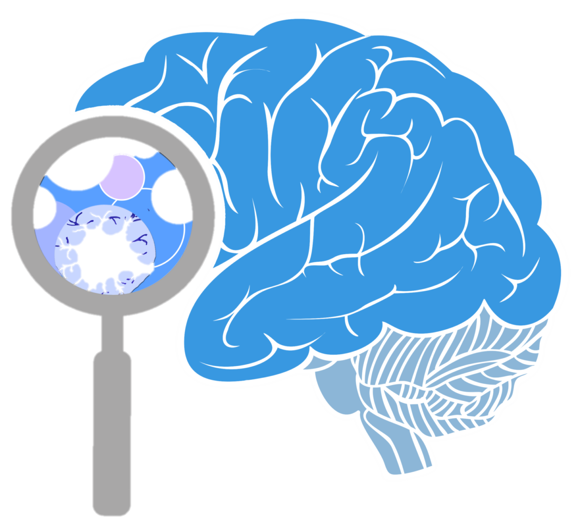
ThinkPlus
?
Notes:
Teacher: What do you think was happening in your brain while you were trying to solve the problem?

Slide 11
ThinkPlus
When you leave this room today,
your brain will not be the same as it was when you entered.
Notes:
Teacher: Remember the quote I showed you at the beginning of the session? Who can remember it? (animation 1) This quote is referring to something called neuroplasticity and it is what you have all been experiencing while you were doing the challenge.

Slide 12
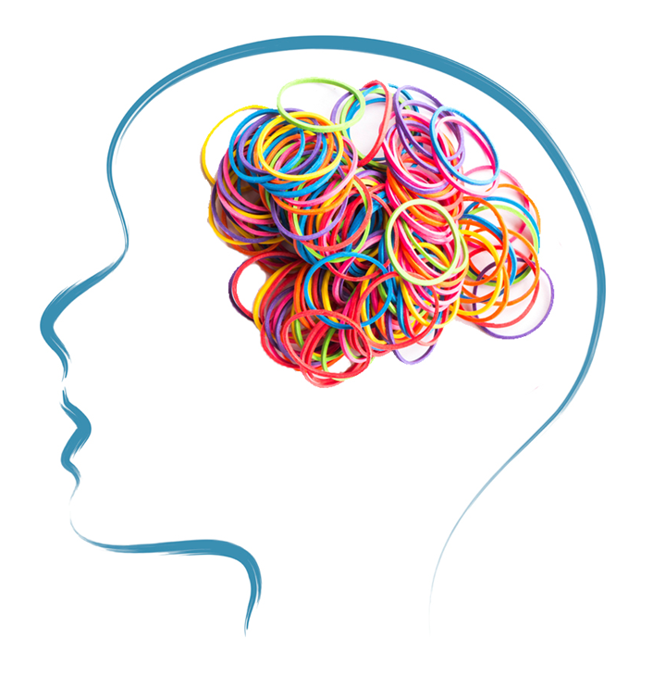
ThinkPlus
Today…
Neuroplasticity
Notes:
Teacher: Today, we are going to explore the concept of neuroplasticity- what it is, how it works and what it means for us. Let’s watch this short video that explains the concept. Then we will look at some real life stories of neuroplasticity at work.

Slide 13

ThinkPlus

Slide 14
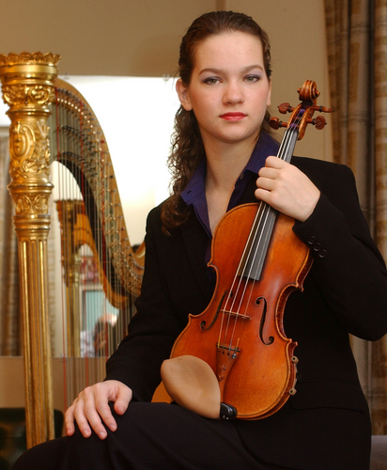
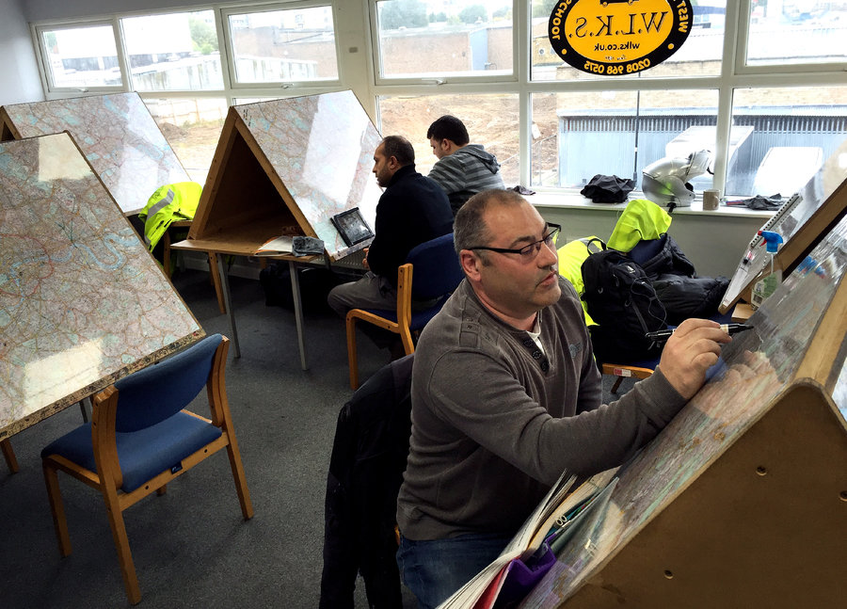
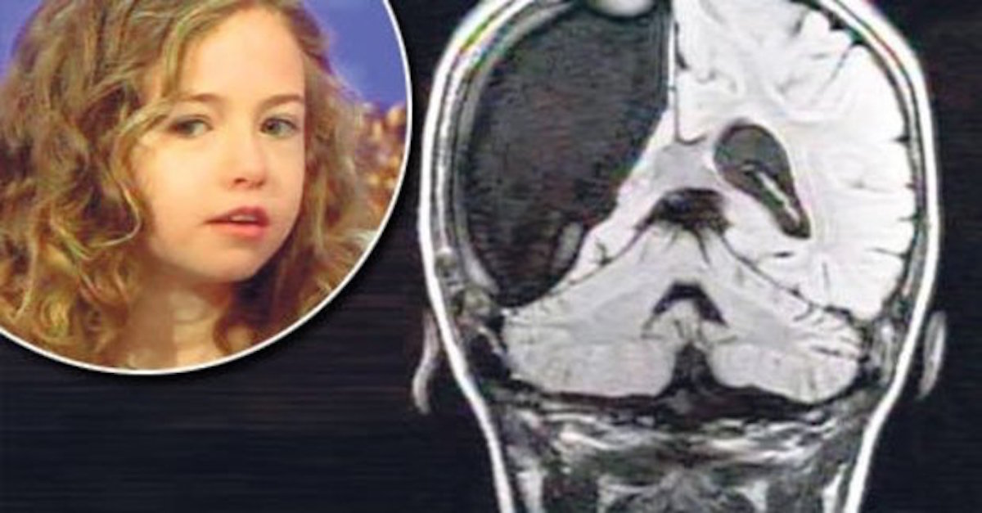
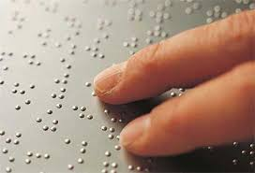
ThinkPlus
London cabbies
Girl with half a brain
Violinist stroke victim
Braille
Notes:
Tell story of London cabbies, girl with half a brain, violinist stroke victim, and people who read braille. (see Neuroplasticity 3 Headlines lesson plan for detail)
Teacher: The next video is about a man – Daniel Kish who lost his sight very young and uses echolocation to find his way around. Does anyone know what that is?
Show video

Slide 15
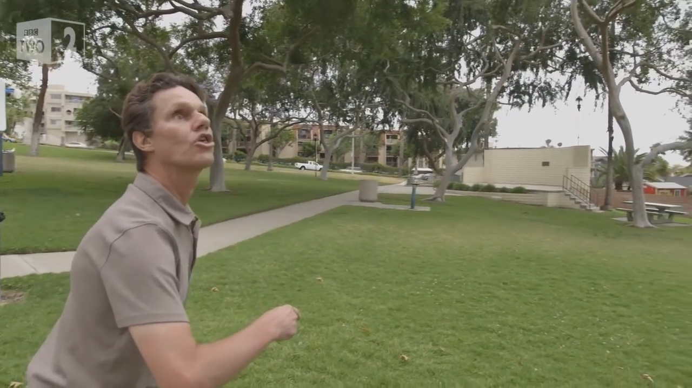
ThinkPlus

Slide 16
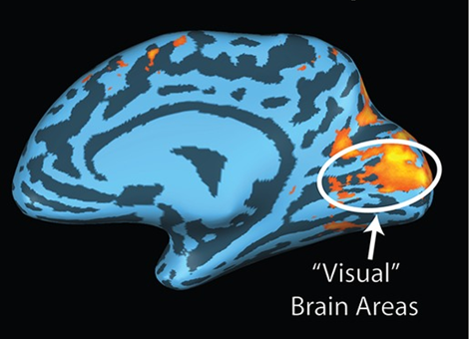
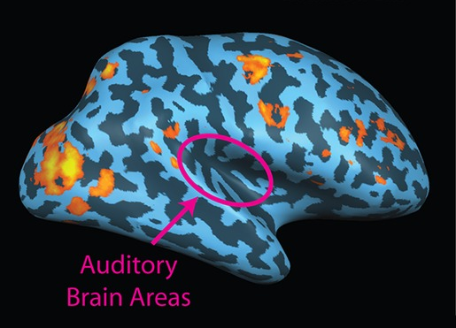
ThinkPlus
Echolocation expert
Notes:
Teacher: The researchers found that when echolocators were listening to their echolocation clicks and echoes, the part of the brain normally used to see lights up. This only happened when listening to their clicks and echoes. Any other sounds heard by the echolocators, only lights up the normal listening part of the brain. This is a very clear demonstration of neuroplasticity, the idea that our experiences can change the structure of our brains.
We are now going to watch the video about neuroplasticity again. While you watch it, think about all the examples you just heard.

Slide 17
ThinkPlus

Slide 18
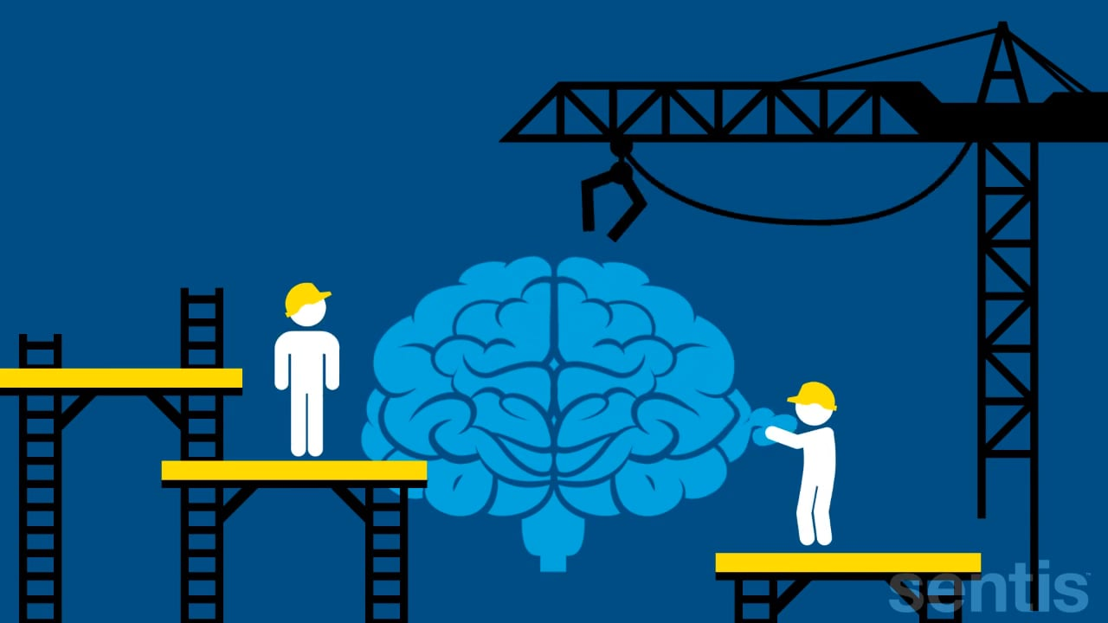
ThinkPlus
Three amazing things….
1.
2.
3.
Notes:
Teacher: We have watched the video twice and you have heard some amazing examples of neuroplasticity at work. Think about three things you find exciting or amazing about neuroplasticity.
I will give you a few minutes to think about these three things. Now I would like you to share them with the person next to you.
Hand out activity sheet- Neuroplasticity 3 – Headlines Activity
Use the first section of the activity sheet to record the top three thoughts you had between you.

Slide 19

ThinkPlus
Headlines
Notes:
Teacher: We are now going to create a headline for each of your group’s thoughts. There is a space on the handout to record these. You will eventually choose one headline to publish. Before you get started, let’s look at some of the basic rules for creating a headline.

Slide 20
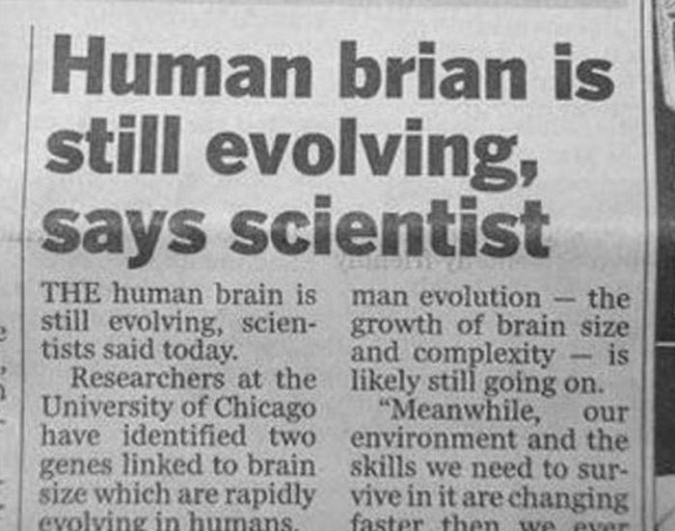




ThinkPlus
Full sentence
Full stop
?? or !!
the, a, an
Present tense
Notes:
Teacher: Have a look at this headline, it is not a full sentence (animation1) It doesn’t have a full stop. (animation 2) You can use a ? or ! to add impact.
(animation 3) You don’t need to use the, a or an but (animation 4) you can use a comma instead of and.
(animation 5) Use present tense – (animation 6) is still, says. It gives more impact as well- it’s not old news.
Can you spot the mistake? (animation 7) Make sure you check your spelling before it becomes a headline itself!!
Using these guidelines, create a headline for each of your group’s thoughts.

Slide 21
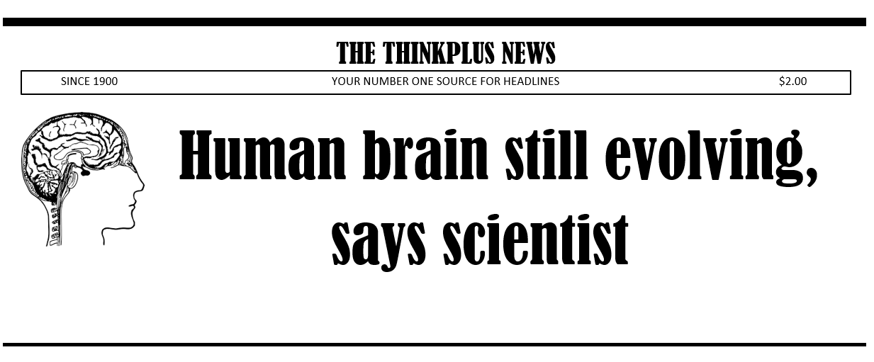
ThinkPlus
Notes:
Teacher: Choose your favourite headline – the one that really captures your group’s thoughts about neuroplasticity. Choose one of the headline templates to display your headline. Use bold clear print that can be read from a distance.
Groups choose from one of the 6 headline templates and add their favourite headline to it. These look great displayed in the classroom. (See photos in Neuroplasticity 3 lesson plan.)

Slide 22
ThinkPlus
When you leave this room today,
your brain will not be the same as it was when you entered.
Notes:
Teacher: Let’s look at the quote we started with.

Slide 23

ThinkPlus
How has your brain changed?
Build the brain you want!
Notes:
Teacher: Think about how your brain has changed while you’ve been learning about possibly the most exciting scientific discovery of all time- Neuroplasticity.
Remember- you have the power to (animation 1) build the brain you want!

