Slide 1
Study Smart 1
Notes:
Teacher: In this session, we are going to look at the way you study. Do you do it efficiently? What is the best way to study? What does your study time look like?

Slide 2

Study Smart
Study time?
Notes:
Teacher: Like this?

Slide 3
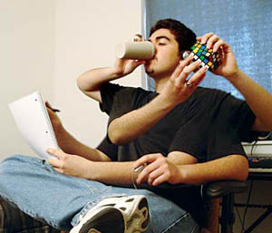
Study Smart
Study time?
Notes:
Teacher: Or this?

Slide 4

Study Smart
Study time?
Notes:
Teacher: Maybe this?

Slide 5

Study Smart
Study time!
Notes:
Teacher: Or even this?
Studying is tough, but sometimes we make it even harder than it should be. We get distracted, lose attention and take twice as long to get something done as we should.

Slide 6

Study Smart
Minimise distractions
Notes:
Teacher: It is very easy to be distracted when it comes to studying. Scientist have found that the time spent studying is greatly increased when the person studying is surrounded by distractions. What are some of the things that might distract you while you are studying? (have one or two students list on board as students suggest distractions) There a few simple things you can do to reduce those distractions, keep you brain focused and get things done faster.

Slide 7

ThinkPlus
Two readers
Notes:
Teacher: We are going to start with an activity demonstrating how distractions affect our brain and therefore our concentration. I will need two volunteers to read two passages about the brain to the group. While the volunteers are reading, see if you can listen to both and remember what each person has read. (both readers read at the same time)
Can anyone tell me exactly what both readers said? Can anyone tell me what Reader 1 read? The other reader? Who found they were switching between the two readers? How did that go? Who just gave up? (students share their experiences) Turns out you can’t actually listen to two things at once. BUT many of us think we can. Let’s look at the science behind why listening to two things at once is impossible.

Slide 8
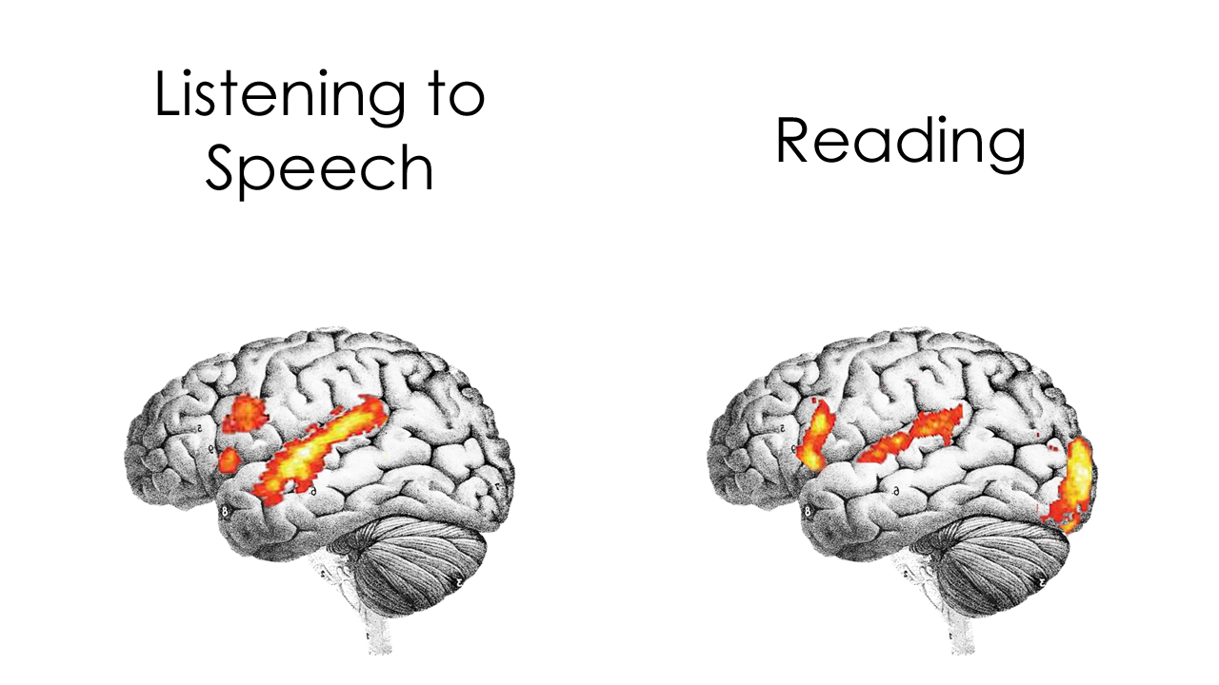
ThinkPlus
Listening to speech
And so…
Notes:
Teacher: When we listen to speech (animation 1) the area of the brain associated with processing speech lights up. Scientist have proven that this area for listening is only capable of doing one thing at a time, so it is impossible to listen to two or more things at once. There are people who say they can (often musicians) but what they are actually doing is switching back and forward from one thing to the other, each time losing a bit of what was said. Some people are just better at quickly switching back and forward but they cant listen and understand two different things at the same time. It is impossible!
(animation 2) And so….. The next slide has more information about the brain. Read it, but at the same time, listen to some different brain information.

Slide 9

ThinkPlus
The human brain cell can hold 5 times as much information as the Encyclopedia Britannica. Or any other encyclopedia for that matter. Scientists have yet to settle on a definitive amount, but the storage capacity of the brain in electronic terms is thought to be between 3 or even 1,000 terabytes. The National Archives of Britain, containing over 900 years of history, only takes up 70 terabytes, making your brain’s memory power pretty darn impressive.

Slide 10
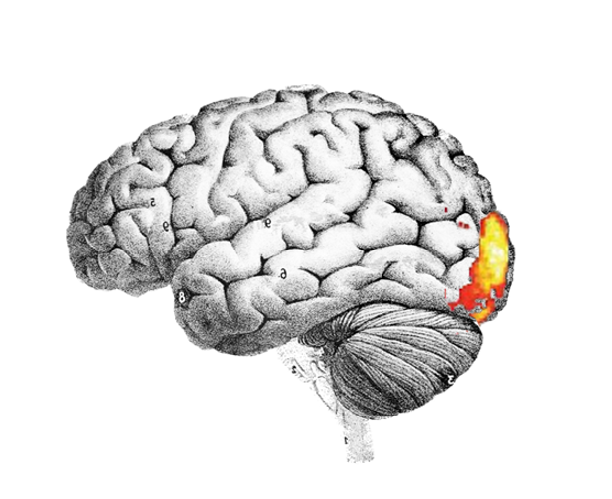
ThinkPlus
Listening to speech
Reading
Notes:
Teacher: Who can recall all the information on the slide? What about the information being read to you? Who found they either read or listened? Who found it very difficult? Who just gave up because it was just too hard? Let’s look at the science behind why we can’t read and listen at the same time. Earlier we looked at the area of the brain used for listening. (animation 1) When we read, (animation 2) the part of the brain associated with vision lights up.

Slide 11
ThinkPlus
Listening to speech
Reading
Notes:
Teacher: But, as it turns out, almost immediately the area of the brain used for listening lights up too. Why is this? Because when we read, we are actually listening to our reading voice. We need to use the listening part of the brain to process what we are reading. As we know, that part of the brain can only process one thing at a time so it is unable to listen to someone else and listen to your reading voice at the same time.
Let’s try another activity to test how well we do when we try to listen and read at the same time.

Slide 12

Study Smart

Slide 13
Study Smart
What colour was George’s hat?

Slide 14
Study Smart
green

Slide 15
Study Smart
What was the girl rewarded with after getting her licence?

Slide 16
Study Smart
chocolate cake

Slide 17
Study Smart
During which season did the girl receive her licence?

Slide 18
Study Smart
summer

Slide 19
Study Smart
What did Linda have for lunch?

Slide 20
Study Smart
baked trout

Slide 21
ThinkPlus
Listening to speech
Reading
Notes:
Teacher: How did that go? Did you miss bits of information? Think about what happens when you are studying – reading something but listening to something else –TV, music, others speaking in the background. Without you realising, your brain switches to that background and then back to your reading. Each time this happens, without realising, your brain has to rewind back over part of what you have read to make sense of the next part of the reading. This switching back and forward, rewinding, wastes precious time and constantly interrupts your flow of understanding, impacting significantly on your learning.

Slide 22

ThinkPlus
Notetaking
Notes:
So what about notetaking? The same problem. When you write, you are listening to your voice saying what you need to write, so the brain area involved in listening is needed when you write. While you are writing your notes, you actually cannot hear what is being said next. Keep notes to a minimum while listening and expand them as quickly after the lesson. You may be able to discuss different ways pf capturing lesson information with your teacher.

Slide 23

Study Smart
Multitasking
Notes:
Teacher: Look familiar? Who has several devices on the go at once? Listening to music, watching a video, typing an essay, replying to a text message while eating? Easy!!! Who believes you can multitask effectively? The next activity will test whether you can.

Slide 24
Study Smart
A B C D E F G H I J K L
1 2 3 4 5 6 7 8 9 10 11 12
Notes:
Students will need a pen and paper.
Teacher: Don’t start yet, but when I say go, I want you to write the letters A to L across the top of your page. Then write ( animation 1) the numbers 1-12 underneath. You will have ten seconds to do this. You may not get it all done but see how far you can get. A ten second timer will count down and sound when your time is up.
The timer will start as soon as you move to the next slide. Call out go as soon as the slide appears.

Slide 25

Study Smart

Slide 26
Study Smart
How did you go?
Notes:
Teacher: How did you go? Did anyone complete it? (there usually are one or two) Anyone get nearly all done? Now fold your paper or turn over so you can’t see what you have just done. Here is the next part of the activity.

Slide 27
Study Smart
A
1
B
2
……
Notes:
Teacher: You will have 10 seconds again and you need to wait until I say go but this time I want you to write the letter A follow by the number 1 (animation 1) then B (animation 2) followed by 2 (animation 3) and continue to the letter L and number 12.

Slide 28
Study Smart

Slide 29
Study Smart
How did you go?
Notes:
Teacher: How did you go this time? Did anyone complete the task? Did anyone do better than they did in the last one? No. Why do you think it took much longer to do the second task? You are actually switching from one task -writing letters- to another –writing numbers- and each time you switch, without realising you have to go back over what you have done in order to continue. This is why you lose so much time doing more than one task at a time.
In the first task, you were monotasking – writing A-L then numbers 1-12. You didn’t have to stop during each monotask and switch to another so you lost no time.
Scientist have found that you CANNOT multitask- you are actually doing exactly what you did in the second task, constantly switching from one task to another and then back again, losing time and concentration – you are distracted.
Check out this next video when two men have a task to complete but are also asked to do several other things at the same time. I don’t think you’ll be surprised by the outcome.

Slide 30
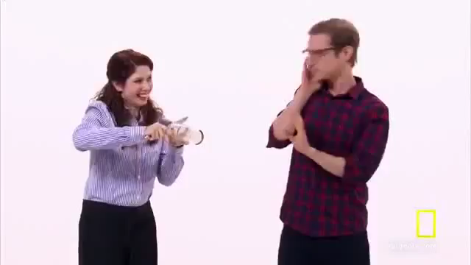
Study Smart

Slide 31
Study Smart
What does this mean for you?
Notes:
Allow time for discussion and reflection. Have students brainstorm some ideas to help them be more organised and less distracted.

