Slide 1
Secondary Module
Famous Failures

Slide 2
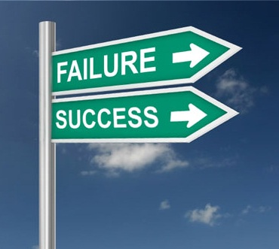
Failure is success if we learn from it…
Notes:
The greatest people in history have been failures. Certainly, we remember these individuals as successes--success stories--and we treat those stories as legends and those individuals as gods. But each of them failed epically and repeatedly. Failure should not be overlooked in anyone, especially not those we admire. It is through failure that these individuals were able to learn, grow and ultimately succeed. We know this about ourselves but even as we learn to accept our own failures, sometimes we don’t recognize that the most successful people in the world have had an abundance of failure.
Our heroes need to be held to the same standard as the ancient Greek gods: awesome but not infallible. Failure is a humbling exercise, both for the observer and the observed. But learning is a humbling process. Once we realize that our heroes are just like us, we can examine how failure drives success. if you’re making mistakes and learning from them, you’re actually on the path to success.
On the next few slides is a quiz. See if you recognise these famous people. I will give you several clues for each. If you do recognise the person before all the clues are revealed, please hold your answer.

Slide 3
Cut from his team, aged 11, because he was too small
Diagnosed with a growth hormone deficiency
Injected legs with growth hormones every night for three years
Left his family and country to achieve his dream
Served tea at a shop to support himself
Now one of the best footballers in the world
Notes:
Reveal each clue, allowing time between each. Do not take answers until all clues are revealed.

Slide 4
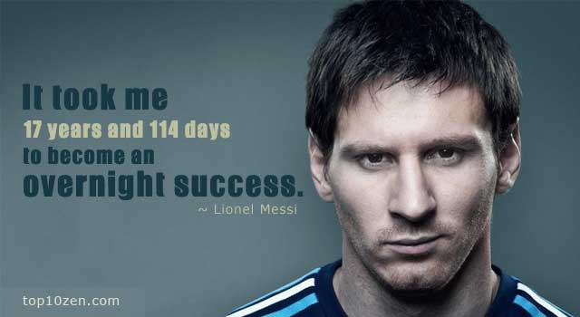
Lionel Messi

Slide 5
Unemployed, single parent living on welfare
Wrote first book in a cafe to save on heating bills
First book rejected 12 times by publishers before being accepted
Became one of the best selling authors of all time

Slide 6
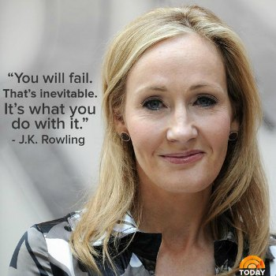
JK Rowling

Slide 7
Did not speak until he was 4 years old
Parents thought he was ‘sub-normal’
Was expelled from school
Teachers said he wouldn’t amount to much
Became the most well-known scientist of all time

Slide 8
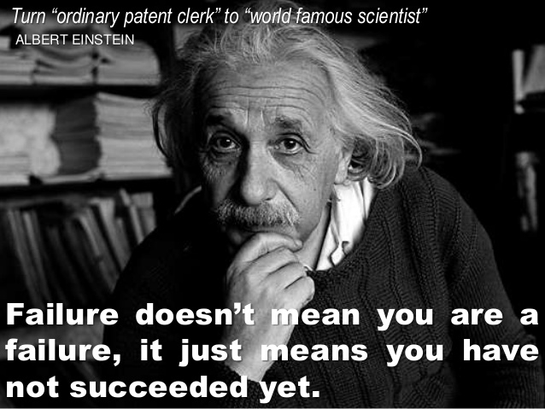
Einstein

Slide 9
Cut from his high school team
Missed more than 9000 shots
Lost almost 300 games
Trusted with the winning shot, he missed in 26 games
Became the greatest basketballer of all time

Slide 10
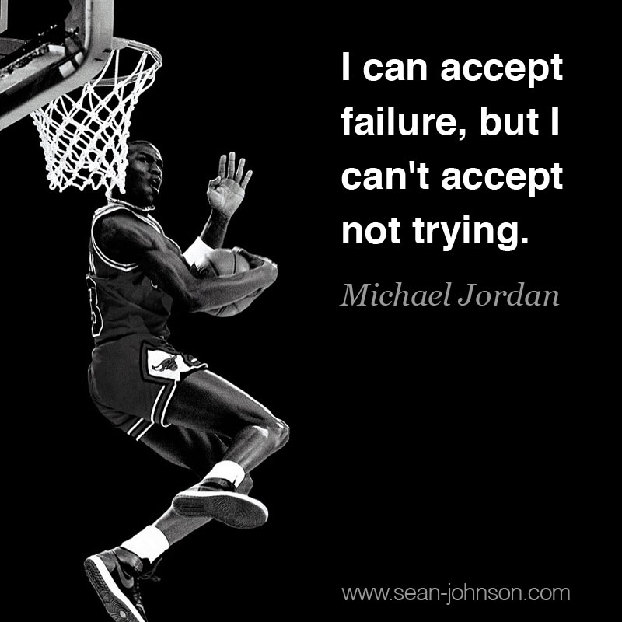
Michael Jordan

Slide 11
Started life in some of the poorest conditions possible in America
Abused as a child and ran away at age 13
Fired from a job as news anchor because she was unfit for TV
Struggled for years to find work in the media
Has her own TV network and is the most recognised woman in the media

Slide 12
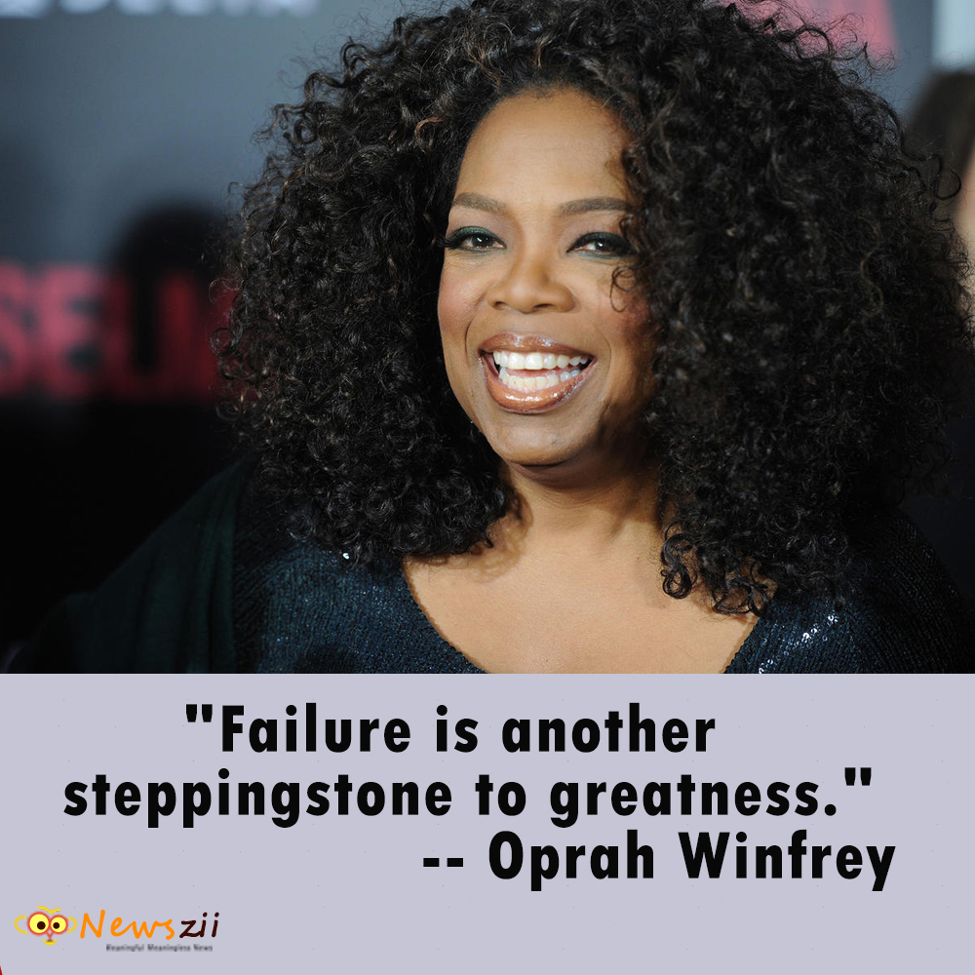
Oprah Winfrey

Slide 13
Dropped out of college to start a business in his garage
Sacked from the company he co-founded, aged 30
Next business failed
Became CEO of one of the world’s largest computer companies

Slide 14
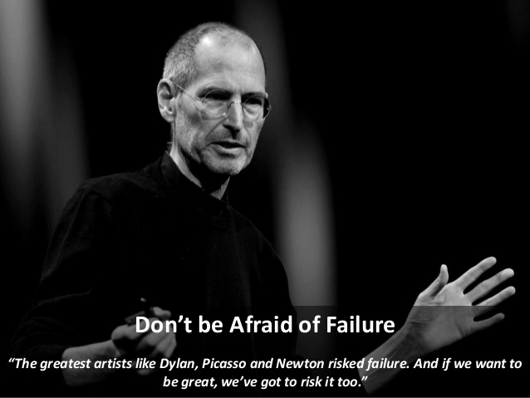
Steve Jobs

Slide 15
Fired by an editor because he lacked ideas and imagination
Started several businesses that failed
Turned down 302 times before he got financing for his idea to create Disneyland
Has earned the most Academy Awards (22)

Slide 16
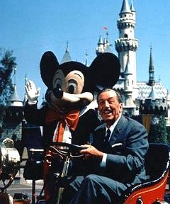
Walt Disney

Slide 17
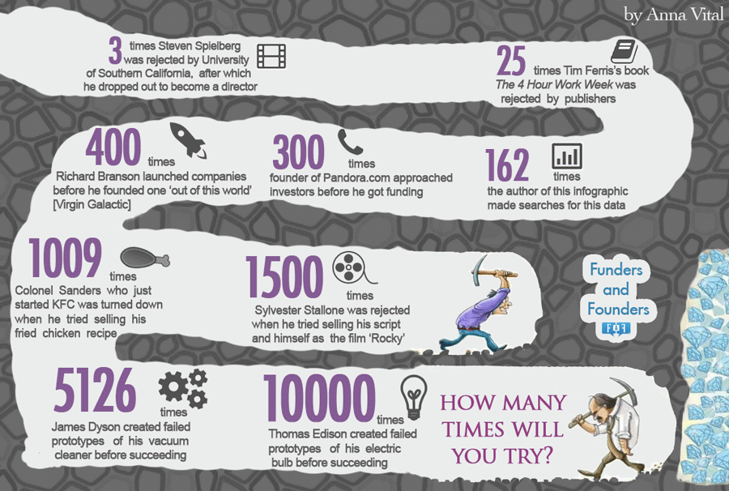
How many times should you try?
Notes:
Each of these famous people failed epically and repeatedly and yet reached amazing heights in their chosen field. So how many times should we try after experiencing failure. Once, twice, even a third time? Look at this number line of attempts and failures made by now famous people. To think Thomas Edison failed an incredible 10,000 times before he was successful in inventing the light bulb.

Slide 18


